Slide 1
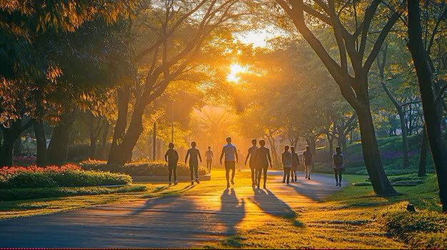
Blessed are you…
A Metaphysical Stroll Through the Beatitudes
Part 2 with Yvonne Racine

Slide 2
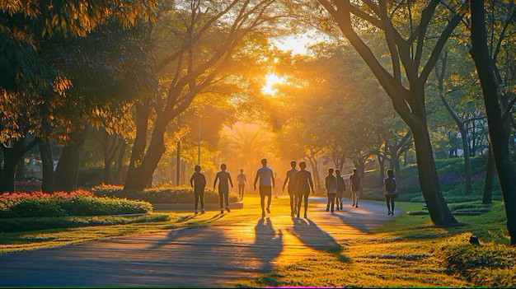
Beatitudes of Jesus
Jesus in exaltation is blessing spiritual man with the attributes of God and also blessing the natural man with the attributes of the spiritual man.
From The Revealing Word

Slide 3
Blessedness of God
The joy that comes from God to those whose thoughts are stayed on Him. “Everlasting joy shall be unto them”. (Isaiah 61:7)
From The Revealing Word

Slide 4
Blessed are the merciful, for they will receive mercy.

Slide 5
Find compassion and forgiveness in your heart for and regardless of what may be happening, you will experience the gift of compassion.
Spiritual Practices: Service, acts of kindness with no agenda, forgiveness.

Slide 6
Blessed are the pure in heart, for they will see God.

Slide 7
Release old grudges, resentments, hatred and limiting beliefs and you will see the Divine in everyone and everything.
Spiritual Practices: Shadow
work, enneagram, meditation.

Slide 8
Blessed are the peacemakers, for they will be called children of God.

Slide 9
End the internal conflict by accepting what is and choosing what is in alignment with your True Self that you may live from your Divine Nature.
Spiritual Practices: Learn to hold
opposites in your heart
without resistance,
Four Voices,
Law of Three work.

Slide 10
Blessed are those who are persecuted for the sake of righteousness, for theirs is the kingdom of heaven.
Blessed are you when people revile you and persecute you and utter all kinds of evil against you falsely on my account. Rejoice and be glad, for your reward is great in heaven, for in the same way they persecuted the prophets who were before you.

Slide 11
Be of good cheer if you should find others or your ego panicking when you’ve made a commitment to live more from Christ consciousness. Persevere, it’s a sign that you're at the gates of heaven.
Spiritual Practices: Prayer, forgiveness, kindness, steadfastness, contemplation, quiet time in the stillness.

